Slide 1
What Podcast to listen to next?
Sara Zong
Feb 26th, 2021

Slide 2
Motivation:
But there are so many podcasts out there, which one should I listen to?
Podcasts could help us learn new things
They are a form of entertainment
You could listen to them anywhere
Notes:
For those who listen to podcast, I think many would say we love podcasts because we could learn many new things from listening. Moreover, podcast is another form of entertainment and you can listen to them anywhere with your device.
But there are so many podcasts out there, which one should we listen to?

Slide 3




Tools:
Notes:
Of course, we could just ask our friends for recommendations. But as data scientists, data can be the friend we ask. I downloaded the podcast review dataset from Kaggle. Then I use natural language toolkit to process the text and use scikit learn to identify topics in the reviews and finally visualize the results with matplotlib.

Slide 4
Podcasts reviews come from Kaggle
Randomly sample ~1million podcast reviews to get ~100k for ~20k podcasts
Review text analysis to identify topics and use these topics for podcast recommendation
Notes:
In the original dataset, there are about 1 million podcast reviews and I randomly sample about 100 thousands for 20 thousands of podcasts to make text analysis more efficient. The goal is to identify topics through text analysis and then use these topics for podcast recommendation.

Slide 5
Text Analysis:
nouns only from reviews
TF-IDF
NMF
cosine distance for recommendation
Notes:
I pull out all the nouns from the reviews, create term frequency inverse document frequency matrix for non-negative matrix factorization. After obtaining the reviews-topic matrix, I group them by podcast and use cosine distance to pull out recommendation.

Slide 6
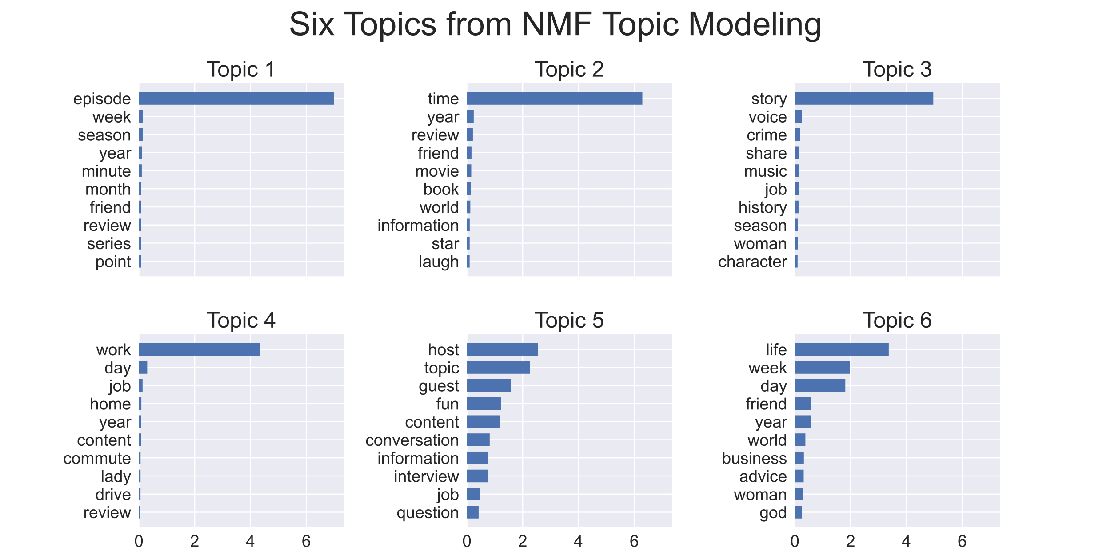
Here are the six topics:
PODCAST SERIES
REVIEW
STORY
COMMUTE
INTERVIEW
ADVICE
Notes:
With NMF, I identify six topics. Here in this plot are the top ten words associated with each topic. For example, topic 4 has words like job, home, commute, drive so I think people are talking about listening to podcast when they commute so I assign the topic commute. Some of the other topics are less obvious, after looking at the top words and also some of reviews under the particular topics, I assigned the other topics to be podcast series, review of book and movie, story, interview, and advice.

Slide 7
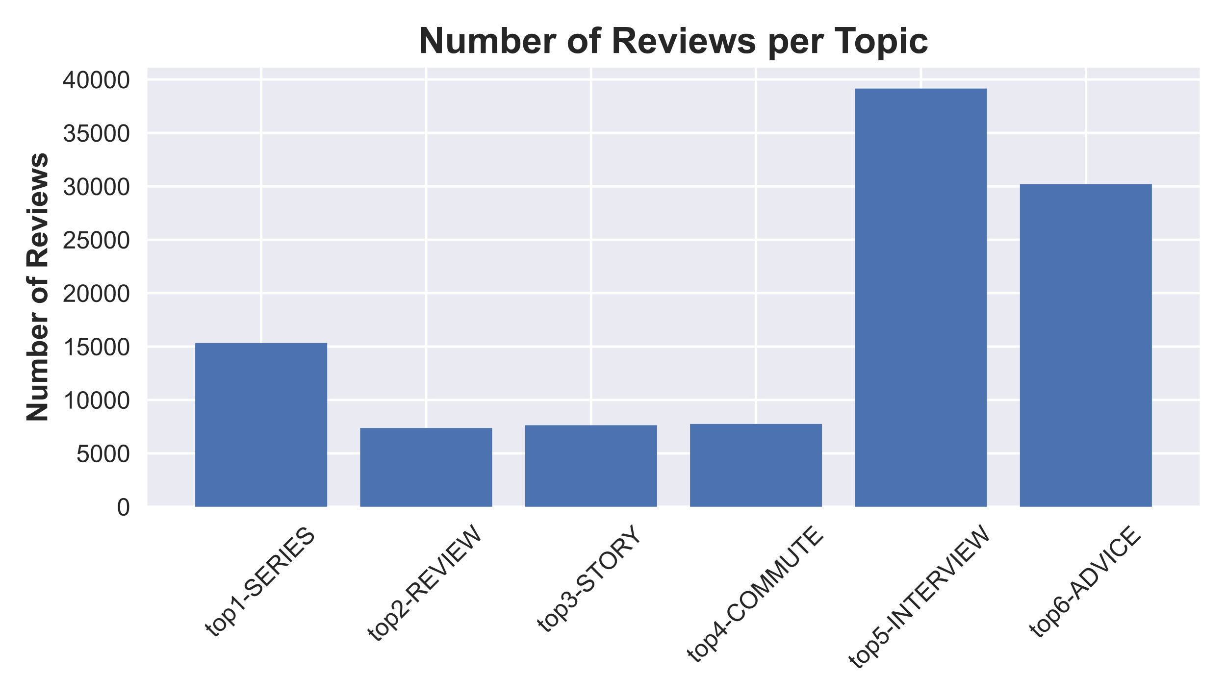
Topic 5 and 6 have more
Reviews than the others:
Notes:
Topic 5 and 6, which are interview and advice have a lot more reviews than the other topics.

Slide 8
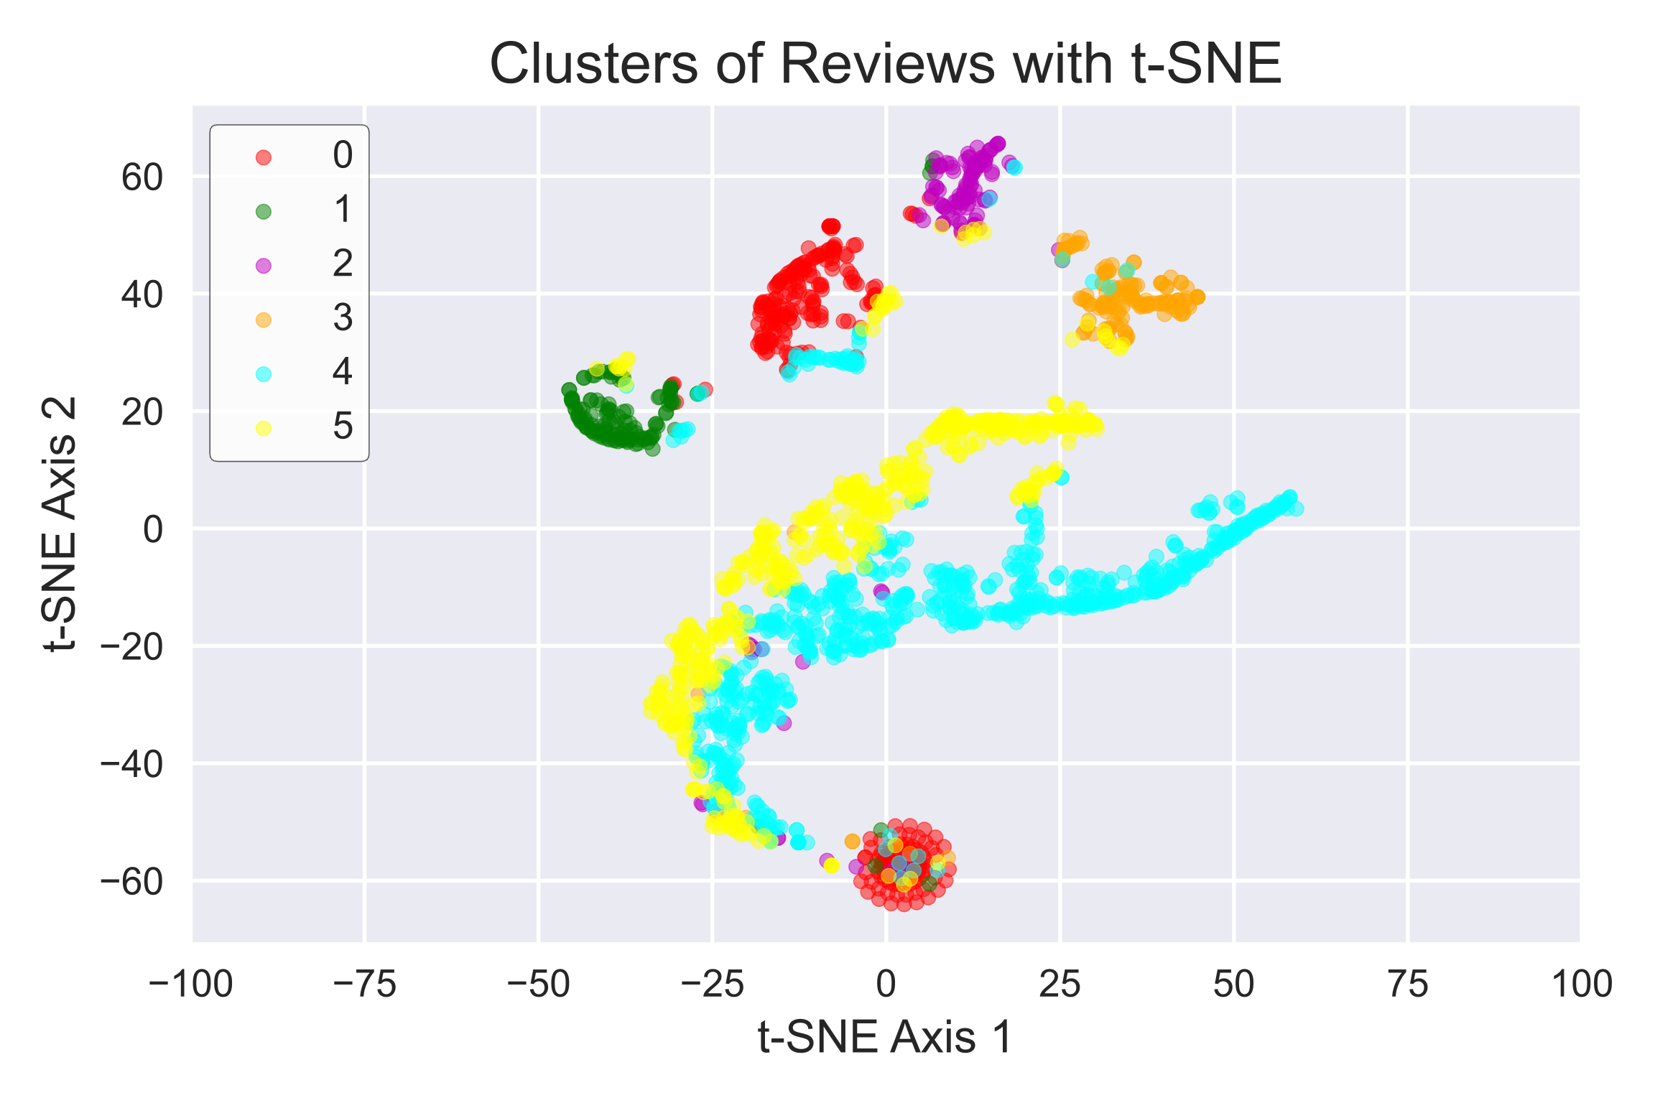
t-SNE reduces six topics to two dimensions:
Notes:
In order to visualize the six topics in a two-dimensional plane, I use tSNE to reduce the dimension of the data. Here are the clusters of a random sample of reviews under the different topics. As you can see here, majority of the reviews can be separated by topics while there is some overlap. An observation I have is that topic 1 actually divides into two groups indicating there might be hidden subtopics.

Slide 9
Recommendation for someone likes Invisibilia:
Apollo 11: What We Saw
Books and Nachos
Planet Money
Slow Burn
Up and Vanished
Notes:
With the topic vectors from NMF for each review, I group reviews by podcast, take the mean of their topic vectors, and then calculate the cosine distance between podcasts. Since I used to listen to Invisibilia, I was curious what the recommendation would be for me. Here are the top five recommendations: Apollo11: What We Saw, Books and Nachos, Planet Money, Slow Burn, and Up and Vanished. I have not heard of those, so I google to find out what they are about. I found none of them really resemble Invisibilia in content, but I found planet money and books and nachos seem to be interesting.

Slide 10
Next Step:
Build a recommender with Google pre-trained Word2Vec to compare
Get description of each podcast and perform text analysis
Notes:
I plan to build a recommender with Google pre-trained Word2Vec to compare. I think it would be helpful to get description for the podcasts and also perform text analysis on that.

Slide 11
Thank you!
Questions?

Slide 12
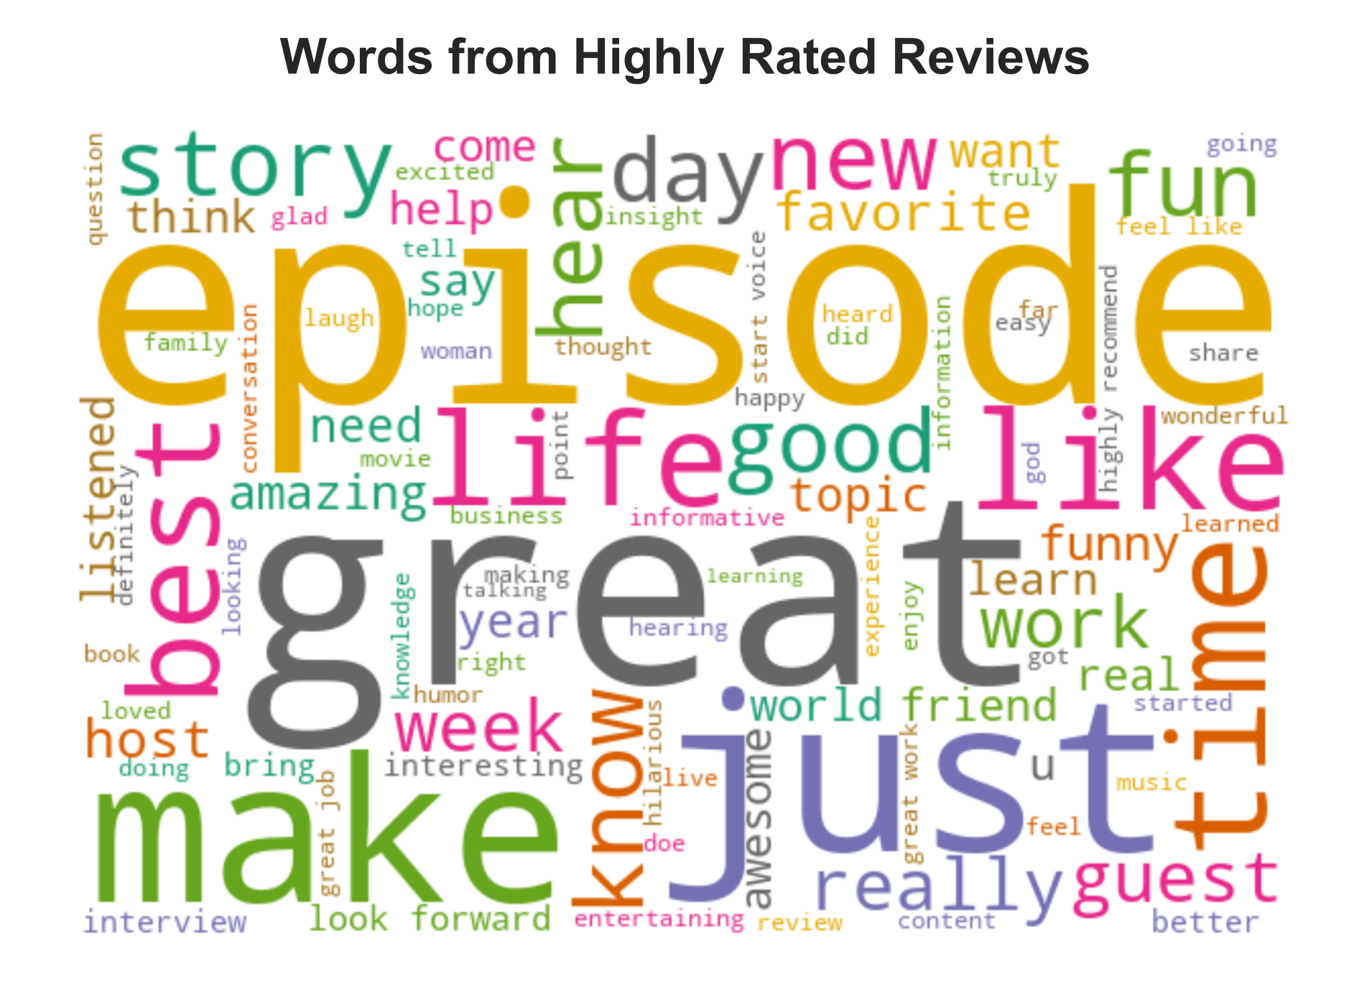
Appendix:

Slide 13
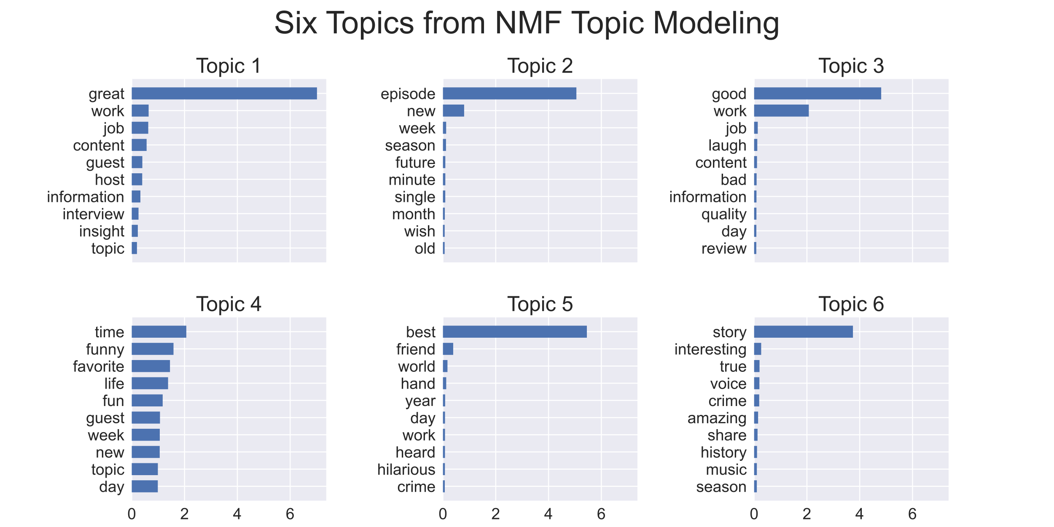
topics with nouns, adjetives

Slide 14
Credits:
Presentation template by SlidesCarnival
https://www.kaggle.com/thoughtvector/podcastreviews

